Slide 1
Natural Language Processing
CSCI 5832—Lecture 8
Jim Martin

Slide 2
Today
Moving on to words and what they might mean.
Chapter 6: Vector semantics

Slide 3
What do words mean?
First thought: look in a dictionary
http://www.oed.com/

Slide 4
Words, Lemmas, Senses, Definitions
lemma
sense
definition

Slide 5
Pepper
Sense 1: spice from pepper plant
Sense 2: the pepper plant itself
Sense 3: another similar plant (Jamaican pepper)
Sense 4: another plant with peppercorns (California pepper)
Sense 5: capsicum (i.e. chili, paprika, bell pepper, etc)

Slide 6
Senses
”Sense” refers to the meaning component of a word
As opposed to its spelling, pronunciation, lexical category, etc.
Words can have many different meanings
Some related, some not
Senses of different words can be related

Slide 7
Relations among senses
Synonymy
Antonymy

Slide 8
Synonymy
Synonyms have the same meaning in some or all contexts.
filbert / hazelnut
couch / sofa
big / large
automobile / car
vomit / throw up
Water / H₂0

Slide 9
Relation: Synonymy
Note that there are probably no examples of perfect synonymy.
Even if many aspects of meaning are identical
Still may not preserve the acceptability based on notions of politeness, slang, register, genre, etc.
The Linguistic Principle of Contrast:
Difference in form -> difference in meaning

Slide 10
Relation: Antonymy
Senses that are opposites with respect to one feature of meaning
Otherwise, they are very similar!
dark/light short/long fast/slow rise/fall
hot/cold up/down in/out
More formally: antonyms can
define a binary opposition
or be at opposite ends of a scale
long/short, fast/slow
Be reversives:
rise/fall, up/down

Slide 11
Relation: Similarity
Words with similar meanings. Not synonyms, but sharing some element of meaning
car, bicycle
cow, horse

Slide 12
Human Similarity Judgements
word1 | word2 | similarity
vanish | disappear | 9.8
behave | obey | 7.3
belief | impression | 5.95
muscle | bone | 3.65
modest | flexible | 0.98
hole | agreement | 0.3
SimLex-999 dataset (Hill et al., 2015)

Slide 13
Relation: Word Relatedness
Also called "word association"
Words be related in any way, perhaps via a semantic frame or field
car, bicycle: similar
car, gasoline: related, but not similar

Slide 14
Semantic Fields
Words that
cover a particular semantic domain
Have structured relations with each other.
hospital
surgeon, scalpel, nurse, anaesthetic, hospital
restaurant
waiter, menu, plate, food, menu, chef
house
door, roof, kitchen, family, bed

Slide 15
Relation: Superordinate/ Subordinate
One sense is a subordinate of another if the first sense is more specific, denoting a subclass of the other
car is a subordinate of vehicle
mango is a subordinate of fruit
Conversely superordinate
vehicle is a superordinate of car
fruit is a subodinate of mango
Superordinate | vehicle | fruit | furniture
Subordinate | car | mango | chair

Slide 16
Connotation
Words have affective meanings
positive connotations (happy)
negative connotations (sad)
positive evaluation (great, love)
negative evaluation (terrible, hate)
Positive: thrifty
Negative: stingy

Slide 17
So far
Concepts or word senses
Have a complex many-to-many association with words (homonymy, multiple senses)
Have relations with each other
Synonymy
Antonymy
Similarity
Relatedness
Superordinate/subordinate
Connotation

Slide 18
But how to define a concept?

Slide 19
Classical Theory of Concepts
The meaning of a word is defined by necessary and sufficient conditions
A necessary condition for being an X is a condition C that X must satisfy in order for it to be an X.
If not C, then not X
”Having four sides” is necessary to be a square.
A sufficient condition for being an X is condition such that if something satisfies condition C, then it must be an X.
If and only if C, then X
The following necessary conditions, jointly, are sufficient to be a square
x has (exactly) four sides
each of x's sides is straight
x is a closed figure
x lies in a plane
each of x's sides is equal in length to each of the others
each of x's interior angles is equal to the others (right angles)
the sides of x are joined at their ends
Example from Norman Swartz, SFU

Slide 20
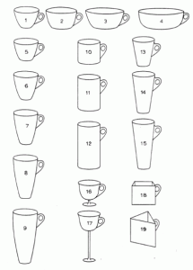
Problem
What are these?
Cups or bowls?

Slide 21
Labov’s Definition

Slide 22
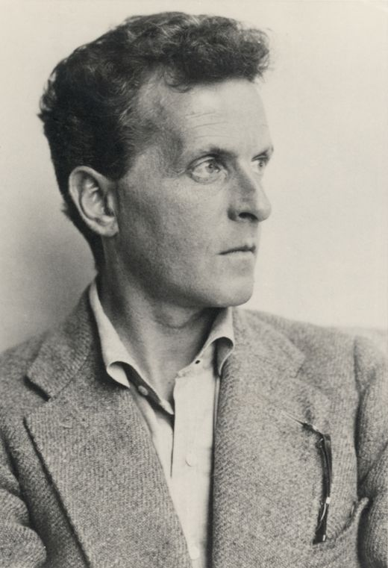
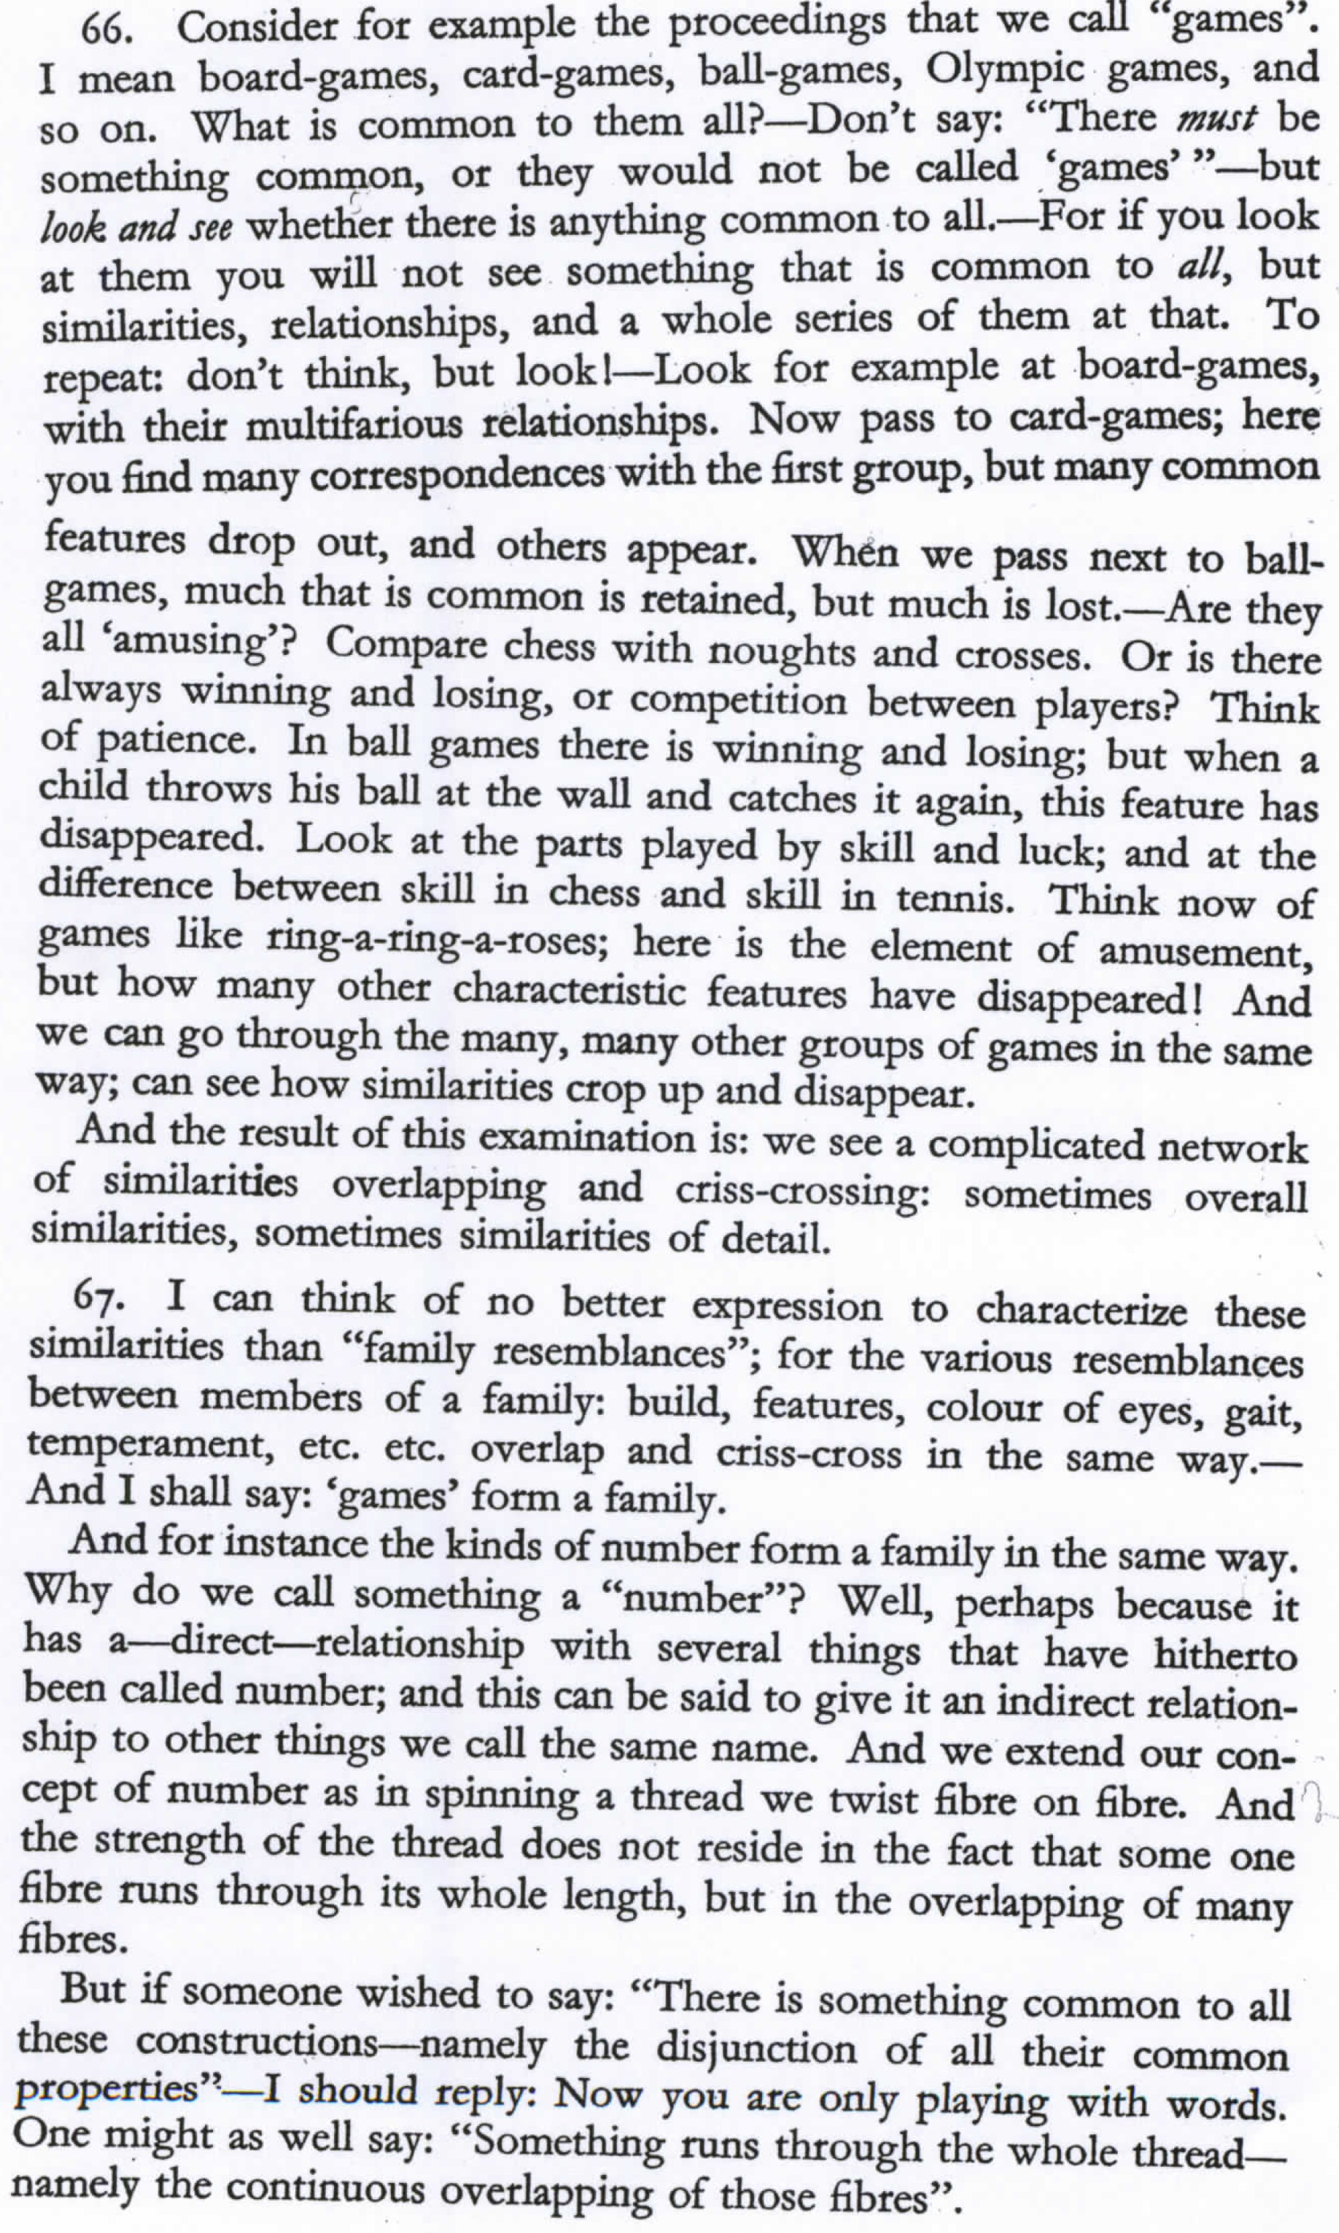
Ludwig Wittgenstein (1889-1951)
What is a game? That is, define game.

Slide 23
What is a game?
PI #66:
”Don’t say “there must be something common, or they would not be called `games’”—but look and see whether there is anything common to all”
Is it amusing?
Is there competition?
Is there long-term strategy?
Is skill required?
Must luck play a role?
Are there cards?
Is there a ball?

Slide 24
Family Resemblance
Game 1 | Game 2 | Game 3 | Game 4
ABC | BCD | ACD | ABD
“each item has at least one, and probably several, elements in common with one or more items, but no, or few, elements are common to all items” Rosch and Mervis
This is definitely not consistent with the classical model based on necessary and sufficient conditions.

Slide 25
Homework

Slide 26
Word Use in Context
In particular, words are defined by their environments (the words around them)
Zellig Harris (1954): If A and B have almost identical environments we say that they are synonyms.

Slide 27
What does ongchoi mean?
Suppose you see these sentences:
Ong choi is delicious sautéed with garlic.
Ong choi is superb over rice
Ong choi leaves with salty sauces
And you've also seen these:
…spinach sautéed with garlic over rice
Chard stems and leaves are delicious
Collard greens and other salty leafy greens
Conclusion:
Ongchoi is a leafy green like spinach, chard, or collard greens

Slide 28
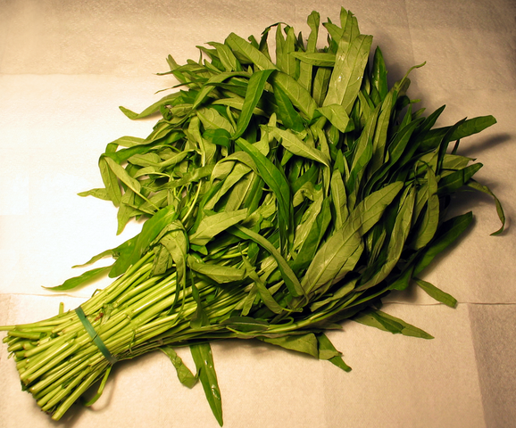
Ong choi: Ipomoea aquatica "Water Spinach"
Yamaguchi, Wikimedia Commons, public domain

Slide 29
Meaning Based on Similarity
Each word = a vector
Not just "word" or word45.
Similar words are "nearby in space"

Slide 30
Words as Vectors
Called "embeddings" because it's embedded into a space
Dominant way to represent word meaning in NLP
Fine-grained model of meaning for similarity
NLP tasks like sentiment analysis
With words, requires same word to be in training and test
With embeddings: ok if similar words occurred!!!
Question answering, conversational agents, etc
Allows for simple methods of composition
“Big dog” == Vector(big) + Vector(dog)

Slide 31
2 Kinds of Embeddings
Sparse: Tf-idf and PPMI
A common model from the information retrieval world
Sparse vectors
Words are represented by a function of the counts of nearby words
Dense: LSA, Word2vec, GLOVE, etc.
Dense vectors
Representation is created by training a classifier to distinguish nearby and far-away words

Slide 32
Term-Document matrix
Each document is represented by a vector of words

Slide 33
Visualizing document vectors

Slide 34
Vectors are the basis of information retrieval
Vectors are similar for the two comedies
Different than the histories
Comedies have more fools and wit and fewer battles.

Slide 35
Words can be vectors too
battle is "the kind of word that occurs in Julius Caesar and Henry V"
fool is "the kind of word that occurs in comedies, especially Twelfth Night"

Slide 36
Word-word matrix (or "term-context matrix")
Two words are similar in meaning if their context vectors are similar

Slide 38
Reminders from linear algebra
vector length

Slide 39
Cosine for Similarity
Sec. 6.3
v_{i} is the count for word v in context i
w_{i} is the count for word w in context i.
Cos(v,w) is the cosine similarity of v and w
Notes:
See Law of Cosines (Cosine Rule) wikipedia page

Slide 40
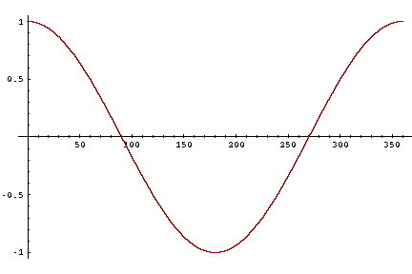
Cosine for Similarity
-1: vectors point in opposite direction
+1: vectors point in same direction
0: vectors are orthogonal
Frequency is non-negative, so cosine range 0-1

Slide 41
 | large | data | computer
apricot | 1 | 0 | 0
digital | 0 | 1 | 2
information | 1 | 6 | 1
Which pair of words is more similar?
cosine(apricot,information) =
cosine(digital,information) =
cosine(apricot,digital) =

Slide 42
Frequency?
Frequency is clearly useful; if sugar appears a lot near apricot, that's useful information.
But overly frequent words like the, it, or they are not very informative about the context
Need a function that resolves this frequency paradox!

Slide 43
tf-idf
tf: term frequency. frequency count (usually log-transformed):
Idf: inverse document frequency: tf-
Total # of docs in collection
Words like "the" or "good" have very low idf
# of docs that have word i
tf-idf value for word t in document d:

Slide 44
Summary: tf-idf
Compare two words using tf-idf cosine to see if they are similar
Compare two documents
Take the centroid of vectors of all the words in the document
Centroid document vector is:

Slide 45
An Alternative: PPMI
Ask whether a context word is particularly informative about the target word.
Positive Pointwise Mutual Information (PPMI)

Slide 46
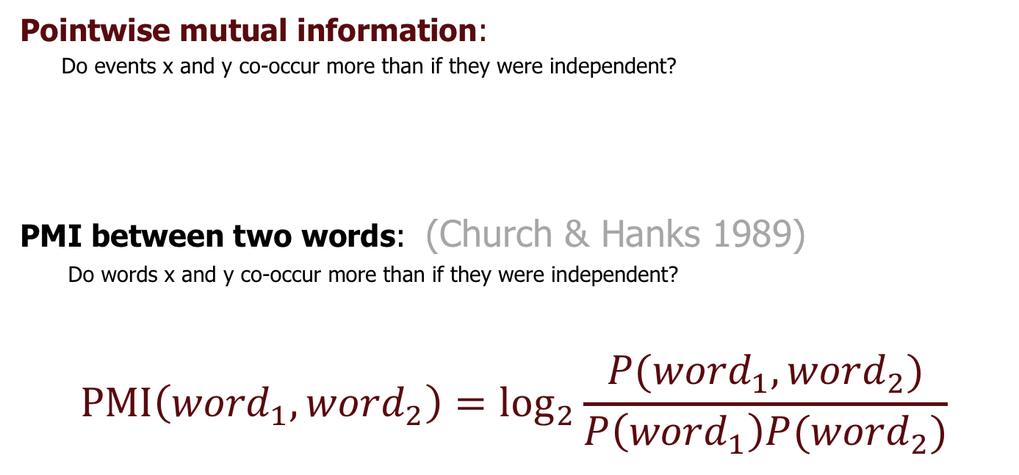
Pointwise Mutual Information
Pointwise mutual information:
Do events x and y co-occur more than if they were independent?
PMI between two words: (Church & Hanks 1989)
Do words x and y co-occur more than if they were independent?
$$\text{PMI}\left({word}_{1}, {word}_{2}\right)={\text{log}}_{2}\frac{P({word}_{1}, {word}_{2})}{P\left({word}_{1}\right)P({word}_{2})}$$

Slide 47
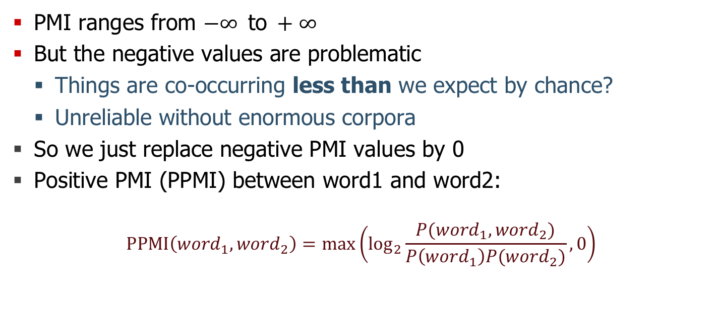
Positive Pointwise Mutual Information
PMI ranges from $−∞ \text{to} +∞$
But the negative values are problematic
Things are co-occurring less than we expect by chance?
Unreliable without enormous corpora
So we just replace negative PMI values by 0
Positive PMI (PPMI) between word1 and word2:
$$\text{PPMI}\left({word}_{1}, {word}_{2}\right)=\max\left({\text{log}}_{2}\frac{P({word}_{1}, {word}_{2})}{P\left({word}_{1}\right)P({word}_{2})},0\right)$$

Slide 48
PPMI on a Term-Context Matrix
Matrix F with W rows (words) and C columns (contexts)
f_{ij} is # of times w_{i} occurs in context c_{j}

Slide 49
PPMI

